Slide 1


IELTS AND GRE EXAMS PROBLEM
Presented By:
Md. Rubaiyat Hasan (2023-3-60-273)
Hafsa Ferdousi (2023-3-60-321)
Nafisa Naowar (2023-3-60-326)
Inteshar Alam (2023-3-60-466)

Slide 2

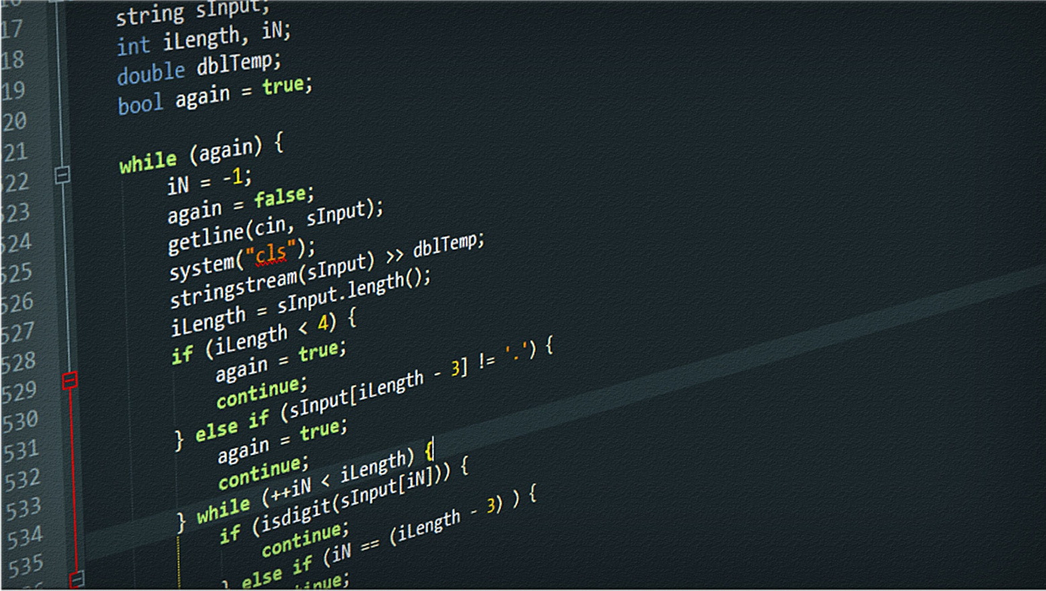
The problem &&
OBJECTIVE
// School mock IELTS and GRE exam
// 300 students, each room max 30
// 1. Assign to each student with a unique ID
// 2. Assign student to a room
// 3. Ensure no overcapacity
// 4. One room per student
// 5. Enter only after exam starts
// 6. No leaving before exam ends
// 7. Attendance summary

Slide 3

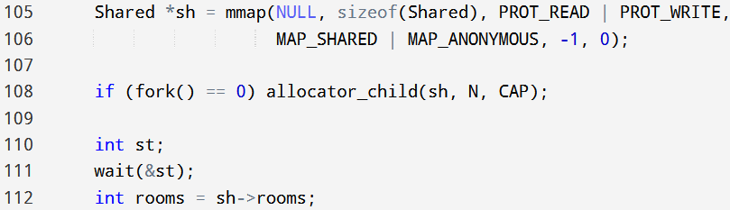
Implementation of Process
A child process is created with fork().
Child runs allocator_child() to assign students to rooms.
Uses shared memory (mmap) so parent and child can communicate.
Parent waits for child to finish (wait(&st)).
Parent then reads sh->rooms (number of rooms) and proceeds.

Slide 4
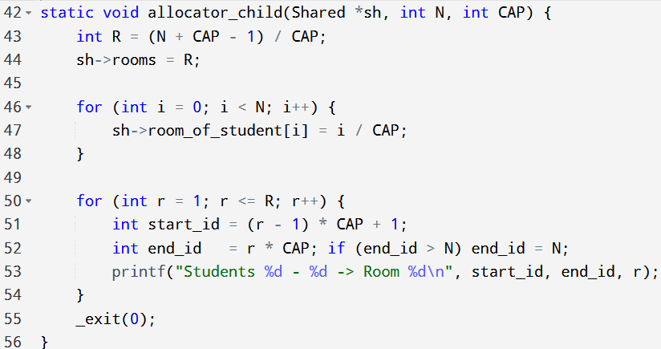
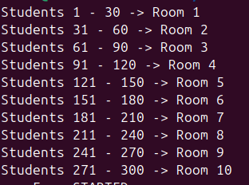
Implementation of Process
Separation of work: Child only assigns ID student → room assignments.
Isolation: Child exits after finishing allocation; parent safely continues.
Scalability: Could extend to multiple children for different tasks in larger systems.

Slide 5
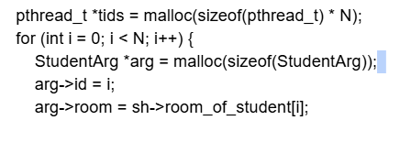
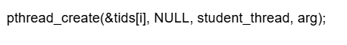
Implementation of Thread
N student threads to model each student’s behavior:
arg->room = sh->room_of_student[i];
This thread is assigned room
pthread_create(&tids[i], NULL, student_thread, arg);
start the thread running student_thread

Slide 6
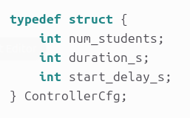
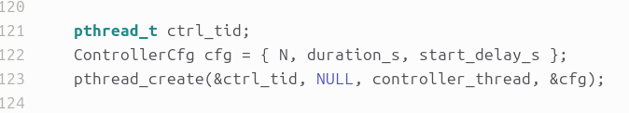

Implementation of Thread
Controller thread to manage timing:
pthread_t ctrl_tid;
Creates a thread handle to store the controller thread’s ID.
ControllerCfg cfg = { N, duration_s, start_delay_s };
Packs the controller’s settings into one struct:
pthread_create(&ctrl_tid, NULL, controller_thread, &cfg);
Starts the controller thread

Slide 7
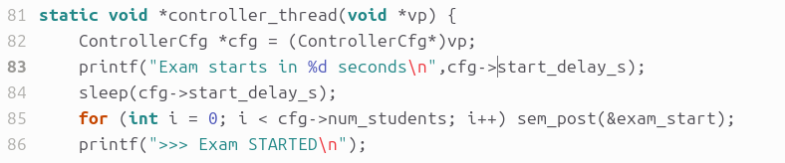
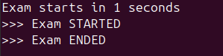
Implementation of Thread
ControllerCfg *cfg = (ControllerCfg*)vp;
Cast the generic argument to struct so we can read start_delay_s, num_students, duration_s
sleep(cfg->start_delay_s);
Waits for a certain period of time before the exam begins
for (int i = 0; i < cfg->num_students; i++) sem_post(&exam_start);
Open the start gate: post one permit per student, so all threads blocked on sem_wait(&exam_start){it is in the student thread function} can proceed
sleep(cfg->duration_s);
Let the exam run for a certain period of time.

Slide 8
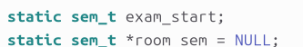
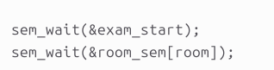
Implementation of Semaphore
All students (threads) call sem_wait(&exam_start) and block until the controller gives the signal.
When the controller does sem_post for every student, they all get released and start entering rooms

Slide 9
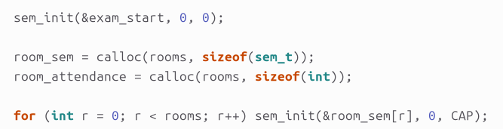
Implementation of Semaphore
room_sem → Used for room capacity management.
Prevents more than CAP students from entering a room.
Students block if the room is full and wait for a slot.
exam_start = synchronization of when students start.
room_sem = synchronization of how many students can be in a room at once.

Slide 10
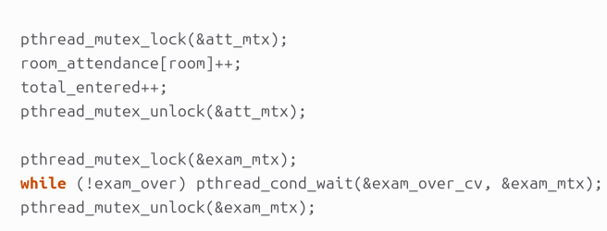
Implementation of Mutex Lock
This ensures safe updating of room_attendance[] and total_entered.
Since many student threads run concurrently, without a mutex multiple threads could write at the same time → causing race conditions (incorrect counts).
So here, the attendance mutex (att_mtx) protects shared count

Slide 11
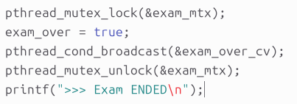
Implementation of Mutex Lock
This uses a mutex (exam_mtx) with condition variable (exam_over_cv).
Students wait for the signal that the exam has ended.
The controller thread locks, sets exam_over = true, and broadcasts to wake up all students.

Slide 12
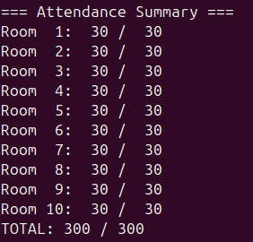

CORE CONCEPTS DEMONSTRATED
Output
Process → allocation of rooms.
Threads → each student is a thread. [ To allow students to enter their designated room only when the exam starts.]
Semaphores → control exam start + room capacity.
Mutex → synchronize exam end.

Slide 13





THANK YOU
EVERYONE

